Slide 1



BUILDING
RECOMMENDATION
ENGINES
WITH SPRING

Slide 2


MICHAEL MINELLA
TWITTER: @MICHAELMINELLA
HOME PAGE: SPRING.IO/TEAM/MMINELLA

Slide 3


WHAT I’M NOT

Slide 4



Slide 5

http://github.com/mminella/RecommendationEngine

Slide 6

THANK YOU
SEBASTIAN SCHELTER
PAT FERREL

Slide 7


Slide 8
11
14
7
12
20
16
5
17
6
3
2
8
18
13
4
1
10
19
23
15
9

Slide 9

Notes:
Look at the site we’ll update
Also look at the technologies we’ll use

Slide 10

RECOMMENDATION
ALGORITHMS

Slide 11

/**
* @author Michael Minella
*/
@Configuration
@ComponentScan
@EnableAutoConfiguration
public class Application {
@Bean
ItemBasedRecommender recommender(DataSource dataSource) {
DataModel dataModel = new MySQLBooleanPrefJDBCDataModel(dataSource);
ItemSimilarity similarity = new MySQLJDBCItemSimilarity(dataSource);
AllSimilarItemsCandidateItemsStrategy candidateItemsStrategy =
new AllSimilarItemsCandidateItemsStrategy(similarity);
return new GenericItemBasedRecommender(dataModel, similarity, candidateItemsStrategy, candidateItemsStrategy);
}
public static void main(String[] args) {
SpringApplication.run(Application.class, args);
}
}

Slide 13
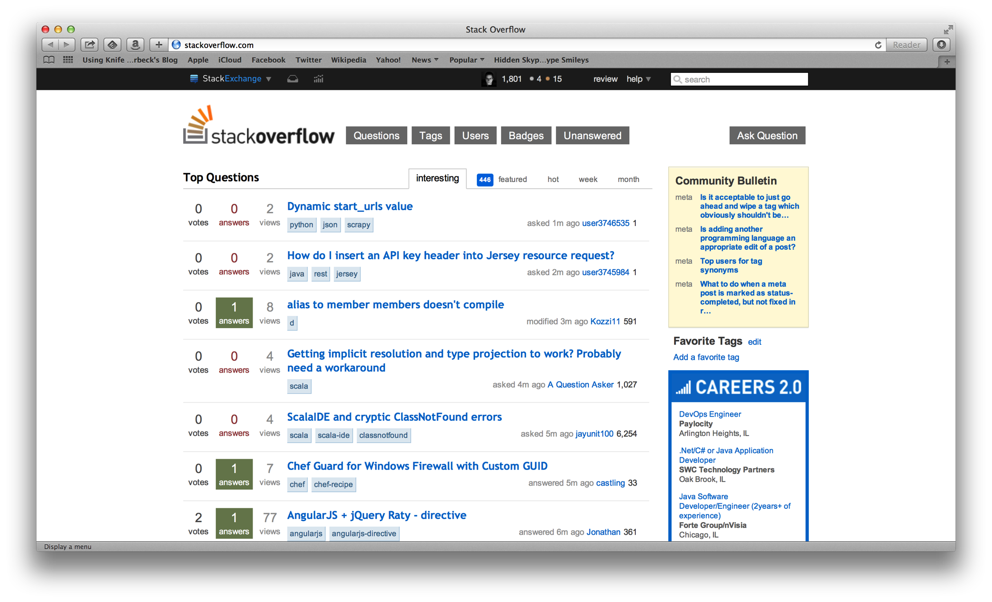

Slide 14
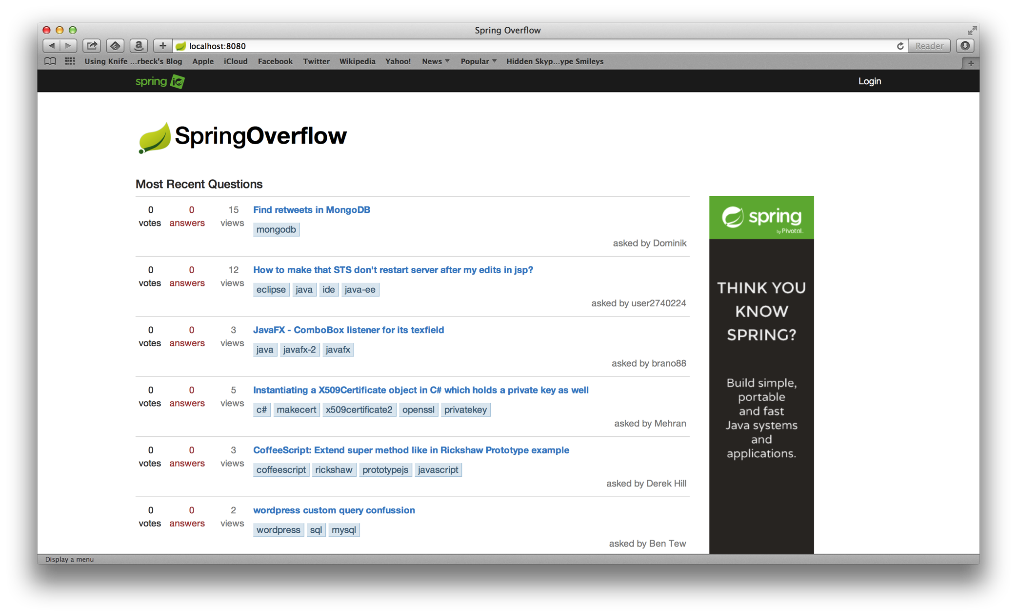

Slide 15
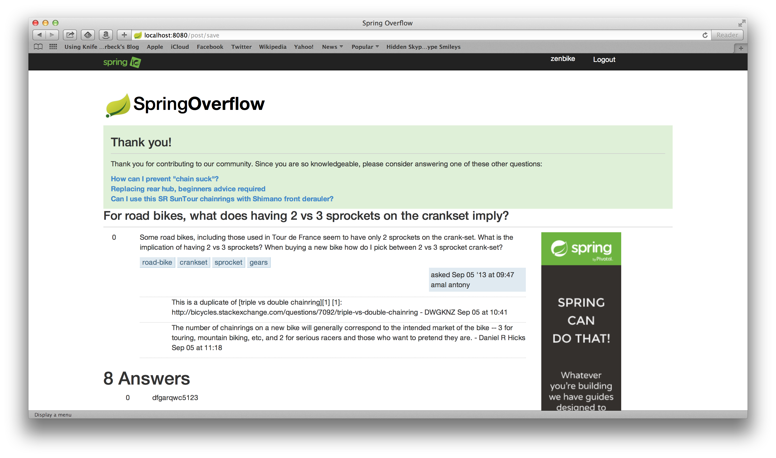

Slide 16
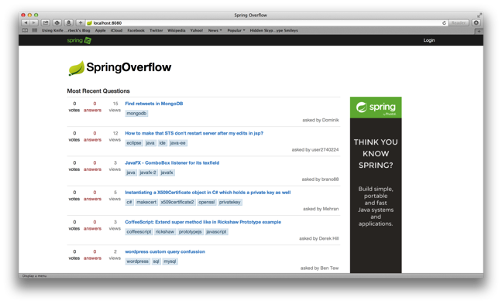



Notes:
Spring XD handles everything in the circle

Slide 17

SCALE OF THE PROBLEM

Slide 18

MILLIONS OF
USERS

Slide 19









100,000’s OF
ITEMS

Slide 20

TOOLS AND
TECHNOLOGIES

Slide 21
1
SPRING BOOT
Notes:
Spring Boot, Spring Data JPA, Spring Core/MVC, Spring Security,

Slide 22
2
MYSQL

Slide 23
3
HADOOP

Slide 24
4
SPRING XD

Slide 25
5
MAHOUT

Slide 26

SPRING XD
EXTREME DATA

Slide 27


APPLICATION
COMPLEXITY

Slide 28
LOTS OF
BOILERPLATE

Slide 29

MANY DOMAINS TO
BRIDGE

Slide 30
INCONSISTENT
APIS

Slide 31

SOURCE, CHANEL, SINK
DATA FLOW MODEL
=
ADAPTER, CHANEL, FILTER, TRANSFORMER, ETC
EIP PATTERNS

Slide 32
JOB, CONNECTOR
IMPORT/EXPORT
=
JOB, ITEMREADER/ITEMWRITER
BATCH PROCESSING

Slide 33
WORKFLOW, ACTION
WORKFLOW
ORCHESTRATION
=
JOB, STEP
BATCH PROCESSING

Slide 34
SPRING XD
EXTREME DATA

Slide 35

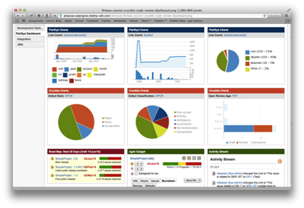





Ingestion
Orchestration
SPRING
Extraction
Real-time
Analytics
Notes:
Spring XD handles everything in the circle

Slide 36

DISTRIBUTED
RUNTIME

Slide 37


&
STREAMING
BATCH

Slide 38
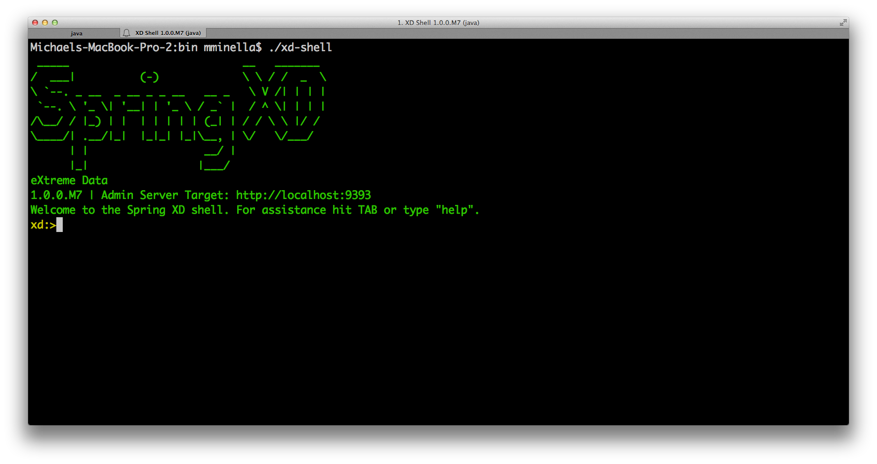

Slide 39
http
|
hdfs
--directory=/xd/dir1
--port=8181
filter --expression=“payload?.price > 3.00” |

Slide 40
BATCH PROCESSING FOR
HEAVY LIFTING

Slide 41

JOB

Slide 42
STEP

Slide 43

CHUNK

Slide 44

TASKLET

Slide 45

SPRING FOR
APACHE HADOOP

Slide 46


Slide 47

TOTAL LINES OF CUSTOM CODE
47 Lines of Java
29 Lines of XML
6 Spring XD Shell Commands

Slide 48
RECOMMENDATION
ALGORITHMS

Slide 49


PREDICTING THE
FUTURE

Slide 50

COLLABORATIVE
FILTERING

Slide 51

TWO OPTIONS

Slide 52

USER BASED
Notes:
Compare users. Determine what users exhibit the same patterns as the current user.

Slide 53
USER
ITEM 1
ITEM 2
ITEM 3
ITEM 4
ITEM 5
DEREK
MICHAEL
PHIL
DARREL
?
Notes:
Compare users. Determine what users exhibit the same patterns as the current user.

Slide 54
USER BASED
Notes:
Compare users. Determine what users exhibit the same patterns as the current user.

Slide 55
USER BASED
Notes:
Compare users. Determine what users exhibit the same patterns as the current user.

Slide 56




ITEM BASED
Notes:
Invented by Amazon (you bought X…you may be interested in Y)
Item Based scales better (a function of your catalog, not your customer base)
Item Based doesn’t need to be updated as frequently

Slide 57
ITEM
DEREK
MICHAEL
PHIL
DARREL
ITEM 1
ITEM 2
ITEM 3
ITEM 4
?
ITEM 5
Notes:
Compare users. Determine what users exhibit the same patterns as the current user.

Slide 58
ITEM BASED
Notes:
Compare users. Determine what users exhibit the same patterns as the current user.

Slide 59
ITEM BASED
Notes:
Compare users. Determine what users exhibit the same patterns as the current user.

Slide 60
PEOPLE ARE
FUNNY

Slide 61
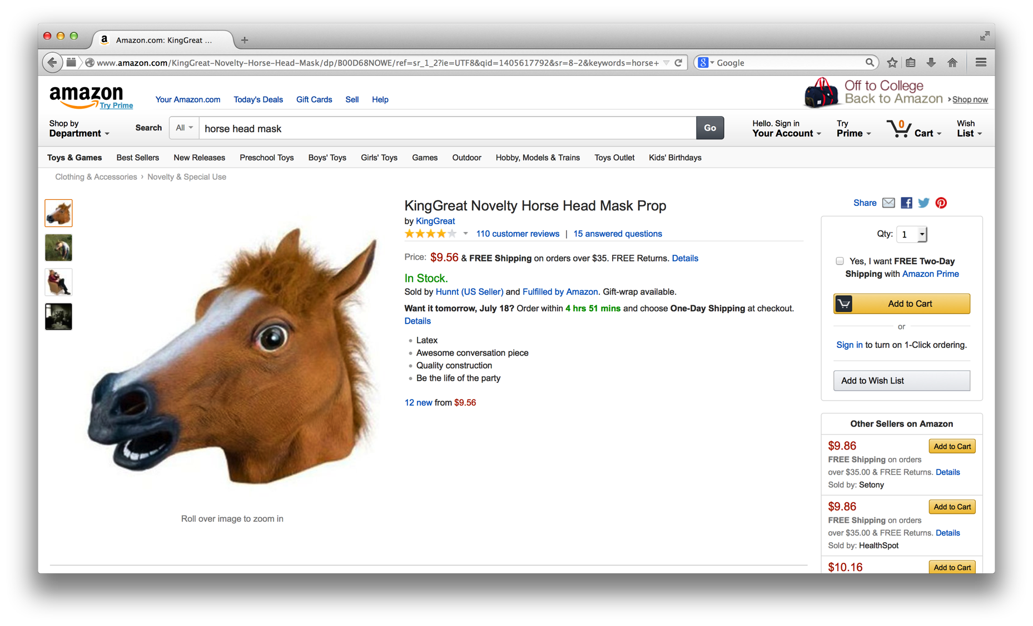

Slide 62
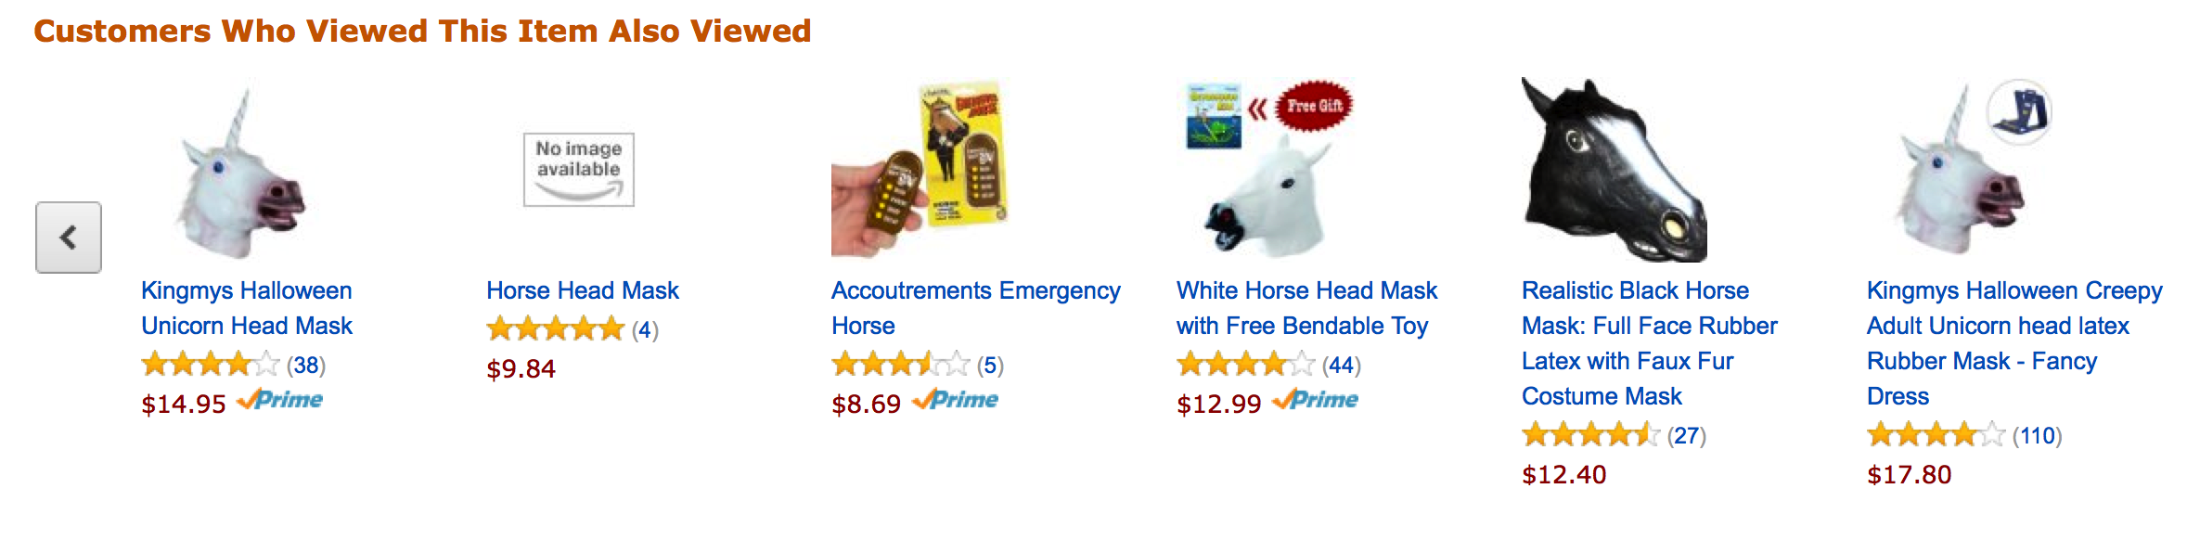
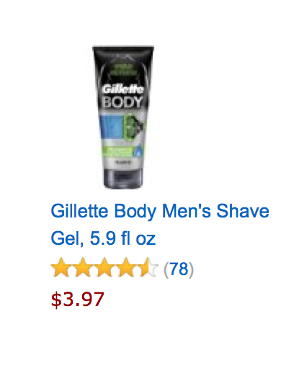
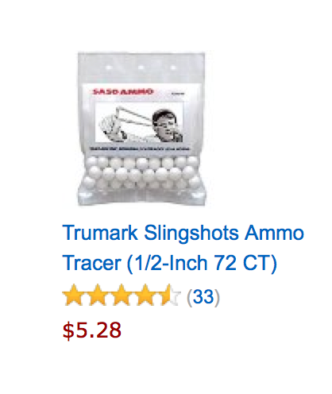

Slide 63
/**
* @author Michael Minella
*/
@Configuration
@ComponentScan
@EnableAutoConfiguration
public class Application {
@Bean
ItemBasedRecommender recommender(DataSource dataSource) {
DataModel dataModel = new MySQLBooleanPrefJDBCDataModel(dataSource);
ItemSimilarity similarity = new MySQLJDBCItemSimilarity(dataSource);
AllSimilarItemsCandidateItemsStrategy candidateItemsStrategy =
new AllSimilarItemsCandidateItemsStrategy(similarity);
return new GenericItemBasedRecommender(dataModel, similarity, candidateItemsStrategy, candidateItemsStrategy);
}
public static void main(String[] args) {
SpringApplication.run(Application.class, args);
}
}

Slide 64
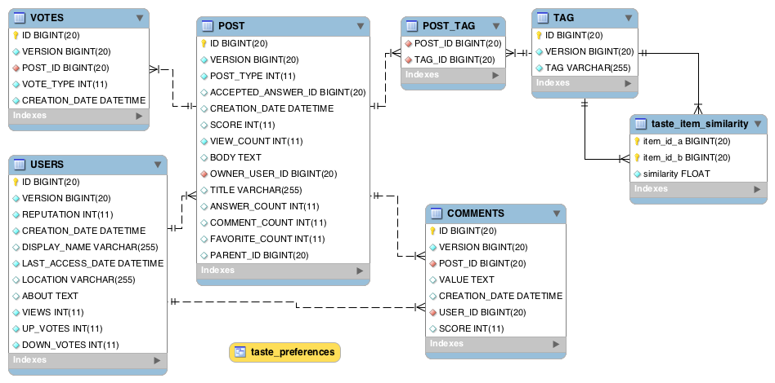

Slide 65
USER_ID, TAG_ID, VOTES
TAG_ID, TAG_ID, SCORE
Notes:
File in HDFS with following format:
userId, tagid, score
Results from Mahout job
tagId, tagId, score

Slide 66
/**
* @author Michael Minella
*/
@Configuration
@ComponentScan
@EnableAutoConfiguration
public class Application {
@Bean
ItemBasedRecommender recommender(DataSource dataSource) {
DataModel dataModel = new MySQLBooleanPrefJDBCDataModel(dataSource);
ItemSimilarity similarity = new MySQLJDBCItemSimilarity(dataSource);
AllSimilarItemsCandidateItemsStrategy candidateItemsStrategy =
new AllSimilarItemsCandidateItemsStrategy(similarity);
return new GenericItemBasedRecommender(dataModel, similarity, candidateItemsStrategy, candidateItemsStrategy);
}
public static void main(String[] args) {
SpringApplication.run(Application.class, args);
}
}

Slide 67
LOOKING INTO THE
FUTURE

Slide 68

NOW WITH
Notes:
In this use case Spark really doesn’t change things.

Slide 69

MAP REDUCE
Notes:
General distributed computing framework

Slide 70

MAP REDUCE
PROBLEMS
Notes:
General distributed computing framework

Slide 71
API IS VERY
LOW LEVEL

Slide 72

HIGH
LATENCY
Notes:
Three steps to the job
Map
Shuffle
Reduce
Can’t do one before the previous one completes

Slide 73

NOT ALWAYS A
GOOD FIT
Notes:
Three steps to the job
Map
Shuffle
Reduce
Can’t do one before the previous one completes

Slide 74
Spark frees you from the constraints of Map/Reduce

Slide 75
Higher level API

Slide 76
More iterative with Spark shell

Slide 77
Potential speed improvements with RDD

Slide 79
/**
* @author Michael Minella
*/
@Configuration
@ComponentScan
@EnableAutoConfiguration
public class Application {
@Bean
ItemBasedRecommender recommender(DataSource dataSource) {
DataModel dataModel = new MySQLBooleanPrefJDBCDataModel(dataSource);
ItemSimilarity similarity = new MySQLJDBCItemSimilarity(dataSource);
AllSimilarItemsCandidateItemsStrategy candidateItemsStrategy =
new AllSimilarItemsCandidateItemsStrategy(similarity);
return new GenericItemBasedRecommender(dataModel, similarity, candidateItemsStrategy, candidateItemsStrategy);
}
public static void main(String[] args) {
SpringApplication.run(Application.class, args);
}
}

Slide 81

The
End

Slide 82

Learn More. Stay Connected.
Twitter: twitter.com/springcentral
YouTube: spring.io/video
LinkedIn: spring.io/linkedin
Google Plus: spring.io/gplus
Spring Batch
Project: spring.io/spring-batch
Github: github.com/spring-projects/spring-batch
Jira: jira.spring.io/browse/BATCH
Spring Boot
Project: spring.io/spring-boot
Github: github.com/spring-projects/spring-boot
Spring XD
Project: spring.io/spring-xd
Github: github.com/spring-projects/spring-xd
Jira: jira.spring.io/browse/XD

Slide 83














Check Box by Hrag Chanchanian
from The Noun Project
Question by Jessica Lock
from The Noun Project
Servers by Jaime Carrion
from The Noun Project
Crane by Kenneth Von Alt
from The Noun Project
Nut by Naomi Atkinson
from The Noun Project
Funnel by Volodin Anton
from The Noun Project
Circuit by Piotrek Chuchla
from The Noun Project
Puzzle by Matthew Hall
from The Noun Project
Network by Mister Pixel
from The Noun Project
Puzzle by Eric M. Ellis
from The Noun Project
People by Wilson Joseph
from The Noun Project
Database by Anton Outkine
from The Noun Project
Fork by Dmitry Baranovskiy
from The Noun Project
Maze by Gilbert Bages
from The Noun Project

